Slide 1


Spend Analytics
DATA SCIENCE PRODEGREE PROJECT

Slide 2
CONTENTS
Project Overview
Exploratory Data Analysis
Feature Engineering
Feature Selection
Model Selection
Insights From The Data

Slide 3




Project Overview

Slide 4
OBJECTIVE
We will analyze and classify the spend data for the procurement function of a company.
This will enable the company to identify the scope for efficiency improvement and better strategic planning.

Slide 5
TASK
Analyze the data and identify purchasing trends and patterns.
Identify the Cost Saving Opportunities by using the Data of procurement.
Cluster Items that have similar purchasing patterns.

Slide 6
Items Segmentation
Items clustered by their purchasing patterns can be used by the companies for implementing various business strategies and decisions.

Slide 7
EXPLORATORY DATA ANALYSIS
Data Set Overview
Feature Selection
Missing Values
Feature Engineering
Outlier Treatment Technique
Standardization Technique
Insights from the data

Slide 8
Data Set Overview

Slide 9
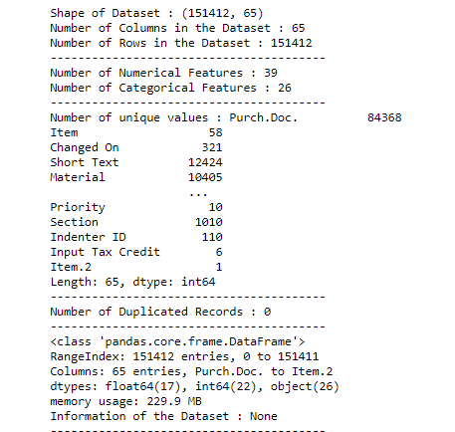
Data Set Overview
Data Set Overview contains info about the data I.e. no of rows and columns, duplicates, no of categorical and numerical features.
On the right hand side, We can also see no of unique values in each column I.e. There are 58 unique items request that we have to cluster depending on the purchasing patterns.

Slide 10
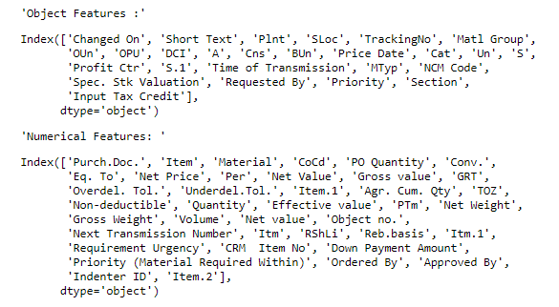
Checking data type of some columns
We can see that the values in feature Changed On and Price Date are datetime values
So, We will convert Changed On and Price Date to datetime datatype.

Slide 11
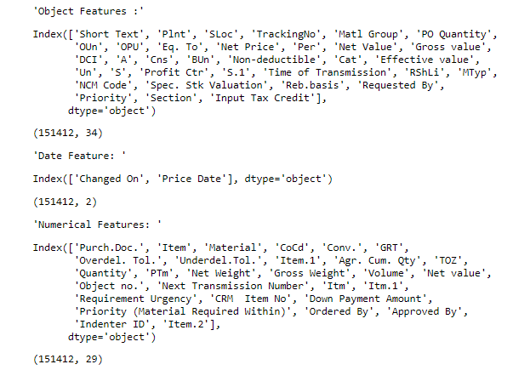
Final Data Type of every column

Slide 12
Feature Selection

Slide 13
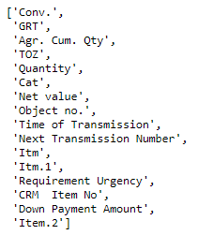
Removing Numeric Features with Constant Variance
We will remove these features because they don't provide any relevant information. Presence of these features has no effect, so it's better to remove them.

Slide 14
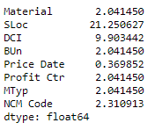
Missing Values
After removing high percentage of missing values, We are left with few features, Out of which Material is a Numeric datatype and Rest of them are categorical in nature.

Slide 15
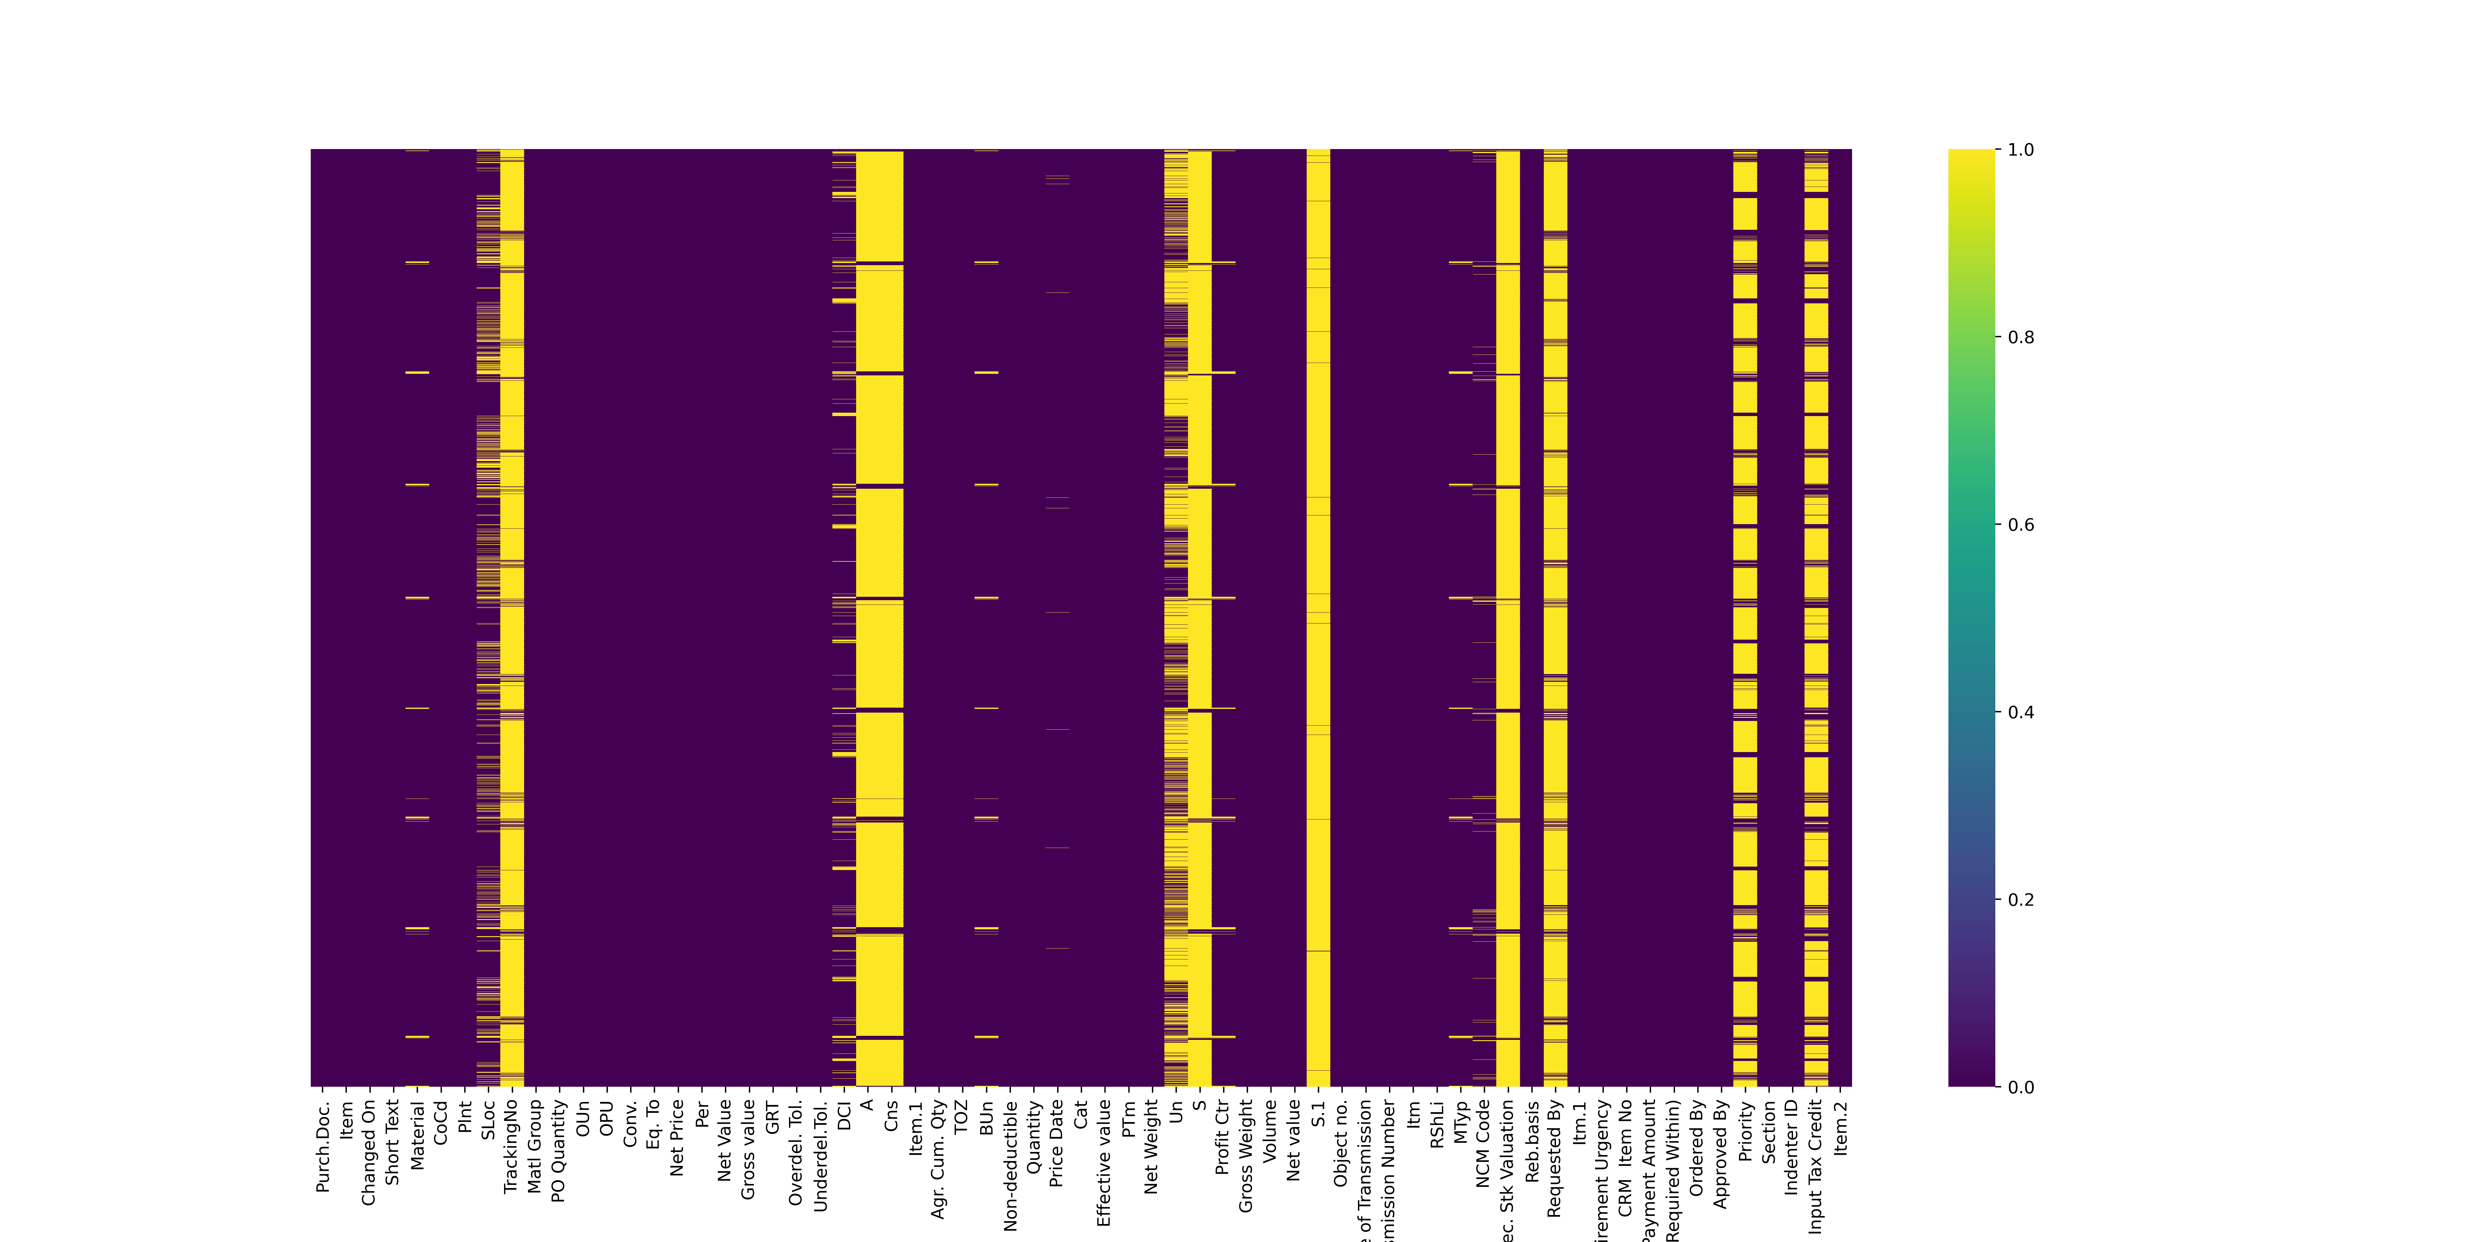
Visualizing Missing Values Using Heatmap
Heatmaps shows us if there is any correlation between missing values in different columns.
From the preceding plot, it is easier to read the spread of the missing values. The yellow marks on the chart indicate missing values.

Slide 16
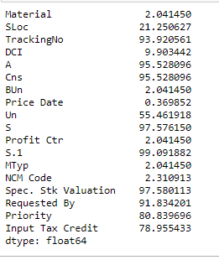
Percentage of Missing Values
We can clearly see that most of the variables have a high percentage of missing values I.e. TrackingNo, A, Cns, Un, S, S.1,Spec. Stk Valuation, Requested by, Priority, Input Tax Credit.
So, We will drop these columns because there is no sufficient data in the given features and can't help us in giving a more useful insights.

Slide 17
In case of Numeric Features , We will be using simple imputer class found in package sklearn.impute. For numerical missing values, a strategy such as mean, median, are more often used.
But here we will be using median strategy to impute missing values as Mean is the only measure of central tendency that is always affected by an outlier.

Slide 18
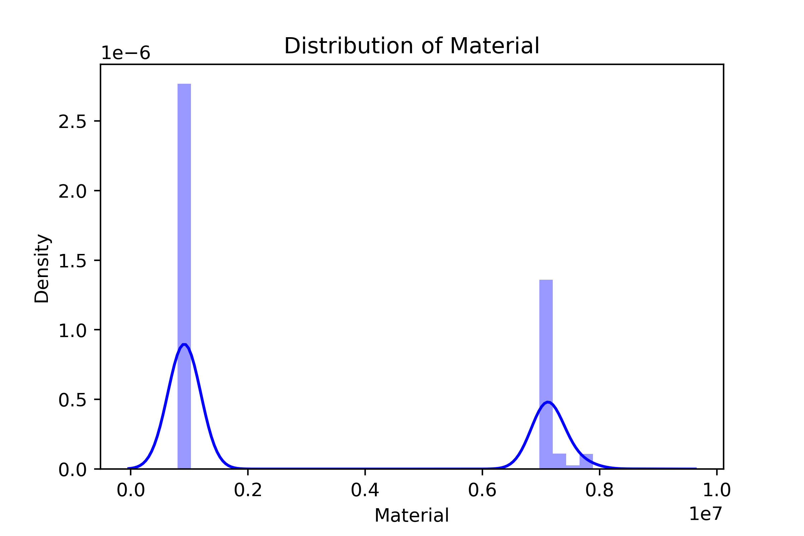

Distribution of Material before imputation and after imputation is same for the Material Feature

Slide 19
Approach – Treating Missing value in SLoc
We will filter out all the rows where storage location for material is missing and see the pattern.
After filtering out, we saw items where storage location is missing, also has a planned delivery time as 0 days. All the items got delivered in 0 days
So, filtering out rows where planned delivery time is 0 days and again checking the frequency of storage location. Max of them belongs to 'CGEN' storage location.

Slide 20
Approach – Treating Missing value in DCI
We alloted a new category I.e. 'N' in DCI after understanding the business problem and the given features
Missing values in DCI can also be said that the items not regarded as closed or not delivered, so we gave them new category N

Slide 21
Approach – Treating Missing value in BUn
We will filter out a the rows where Basic unit of measure is missing and see the pattern in other features.
After filtering, We see that items whoes basic unit is missing belongs to the material no 950028.0 and space the material occupies I.e. Volume is also 0.
So, Filtering the rows with the above condition where Material is 950028.0 and Volume is 0, We will check the feature BUn and impute the missing rows with its most occuring measure I.e. EA basic unit of measure

Slide 22
Approach – Treating Missing value in Profit Ctr
We will filter out a the rows where Profit Centre is missing and see the pattern in other features.
Missing profit centres belongs to EA basic unit of measure in purchasing doc item
So, We will filter out the above condition where basic unit of measure is EA from the original dataset and impute the most frequent date.

Slide 23
Approach – Treating Missing value in NCM Code
We will replace the missing values in NCM Code with its statistical meausres like mode.

Slide 24
Approach – Treating Missing value in PriceDate
We will replace missing values using techniques like backward fill and forward fill in order to provide consistency in the date column.

Slide 25
Feature Engineering

Slide 26
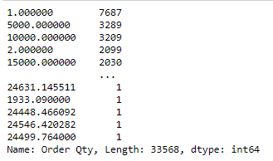
Order quantity
We will derive new feature I.e. Order Qty from Net Price and Net Value of the Item that shows the ordered quantity of the given item.
Order Quantity = Net Value / Net Price

Slide 27
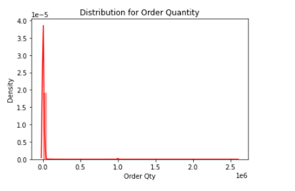
Order quantity
Issue – After deriving this feature, We are getting nan values where net value and net price is 0.
So, Replace the nan values with 0 because the given item have 0 net price and value.

Slide 28

Packaging weight
We will derive one more feature I.e. Weight pkg of item from Gross Weight and Net Weight of the Item that shows the weight packaging of the given item.
Weight of packaging = Gross Weight – Net Weight.
It shows the value counts of every unique value in weight pkg. Max of the items have 0.0 weight in packaging.

Slide 29
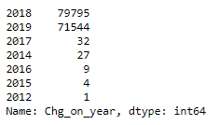
Last changed on year
We will get this feature from a Changed on column which shows the dates on which last changed done on purchasing document.
We will split the changed on into year and keep the year feature as a purpose of our analysis.
Newly derived feature shows the last changes occurred on which year.
Maximum of the changes in purchase document made in the year 2018 and 2019

Slide 30
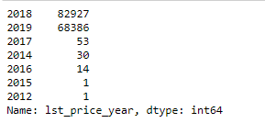
Year on which system determined last net price
We will get this feature from a Price Date column which shows the dates on which system determined the last net price.
We will split the Price Date column into year and keep the year feature as a purpose of our analysis.
Newly derived feature shows the year on which system determined last net price.
Here also, maximum of the changes in net price made in the year 2018 and 2019

Slide 31
Outlier Technique

Slide 32
We will be using IQR(Inter Quartile Range) to bring the values within a quartile range and makes our data points fall in a within a certain range.
The algorithm aims to minimize the squared Euclidean distances between the observation and the centroid of cluster to which it belongs. But sometime K-Means algorithm does not give best results. It is sensitive to outliers.

Slide 33
Standardization Technique

Slide 34
Standardizing Data Is Recommended because otherwise the range of values in each feature will act as a weight when determining how to cluster data, which is typically undesirable.
We will be using StandardScaler to standardize our data

Slide 35
Insights from Data

Slide 36
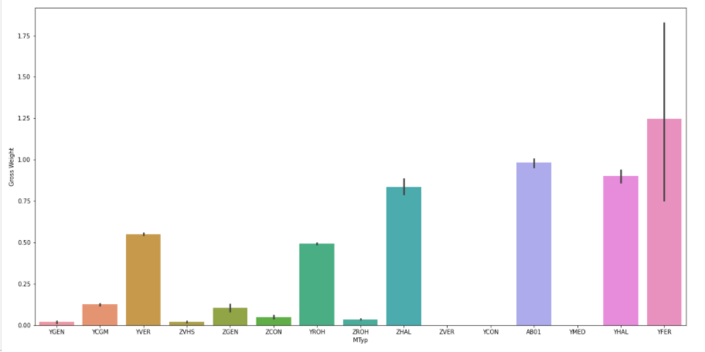
Gross Weight in different Material Types
Material Type YFER has larger Gross Weight whereas Items with material type ZVER,YCON and YMED has no gross weight

Slide 37
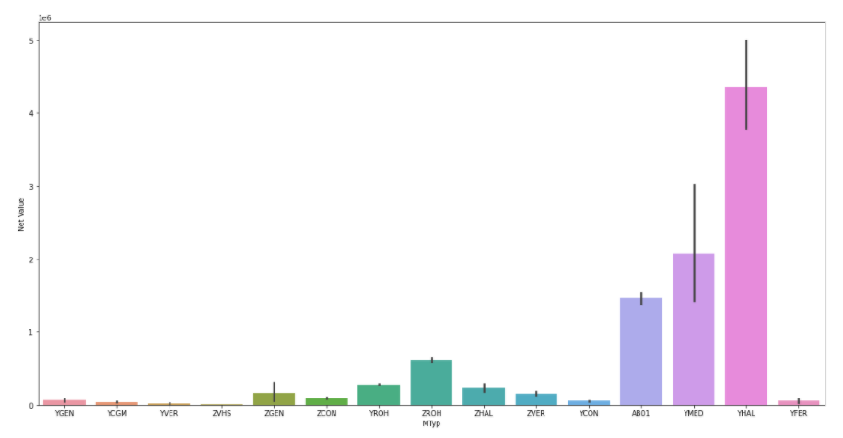
Net Value of different Material Types
Material type YFER , YGEN, YCGM, YVER,ZVHS have minimum net value
whereas material YMAL has high net value.

Slide 38
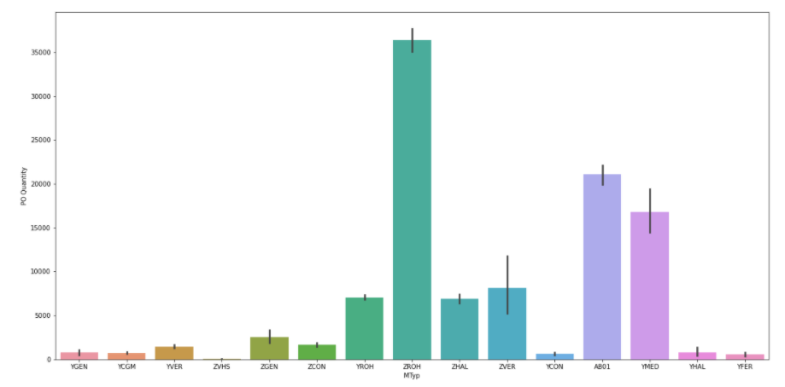
Purchase Order Quantity of different Material Types
Purchase order quantity is less for the material types YFER,YGEN, YCGM, YVER,ZVHS

Slide 39
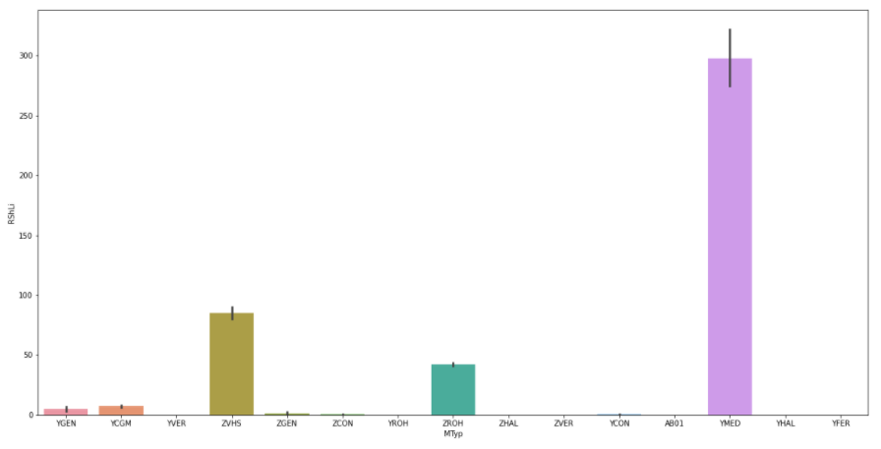
Remaining shelf life of different Material Types
Remaining shelf life is also minimum for the materials like YFER, YGEN,YCOM,YVER

Slide 40
OBSERVATIONS FROM THE PLOTS
YFER material types are heavy in weight but have less net value This imply that they are not ordered in much quantity , If we observe remaining shelf life for such materials, Its quite low
AB01 material has maximum gross weight and price per unit so this is a heavy item, purchase order qty is max for them, with min shelf life

Slide 41
RECOMMENDATION
Avoid using YHAL due to low purchase qty and high net value, it's remaining shelf life is also minimum,
Priority for such materials is also high(so, recommendation - to reduce its priority because we're getting less purchase orders)
ZROH material has high demand as we can see through purchase order qty and also it's net value is moderate so, company should keep such material type more in supply
YROH material have high priority but high purchase qty with moderate net price, hence company must supply more of this material type.

Slide 42
Model Selection

Slide 43
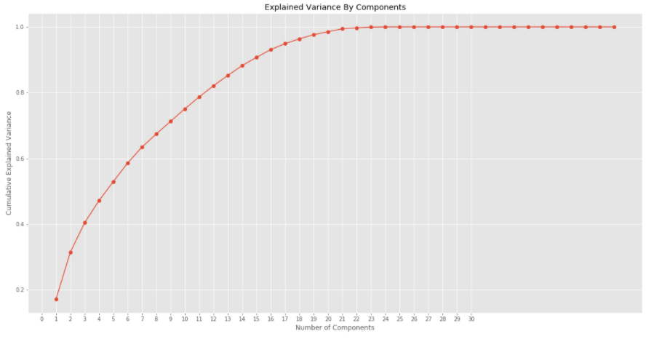
Our data is in high dimensions with various numeric and categorical features. So , to reduce the numerice features , We have applied pca and taking components as 15 so that to preserve the maximum 85 percent variance of the given features.

Slide 44
Thus, PCA works on the numerical features. So, we apply mca to reduce our categorical features and later, combine the components of PCA and MCA.
After getting the final components, We will use these components as a new features to perform clustering.

Slide 45
Cluster wise Analysis

Slide 46
Cluster 1

Slide 47
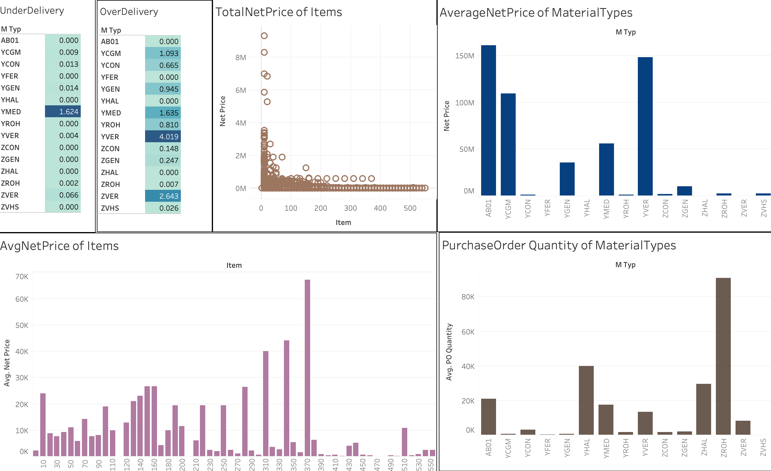

Slide 48
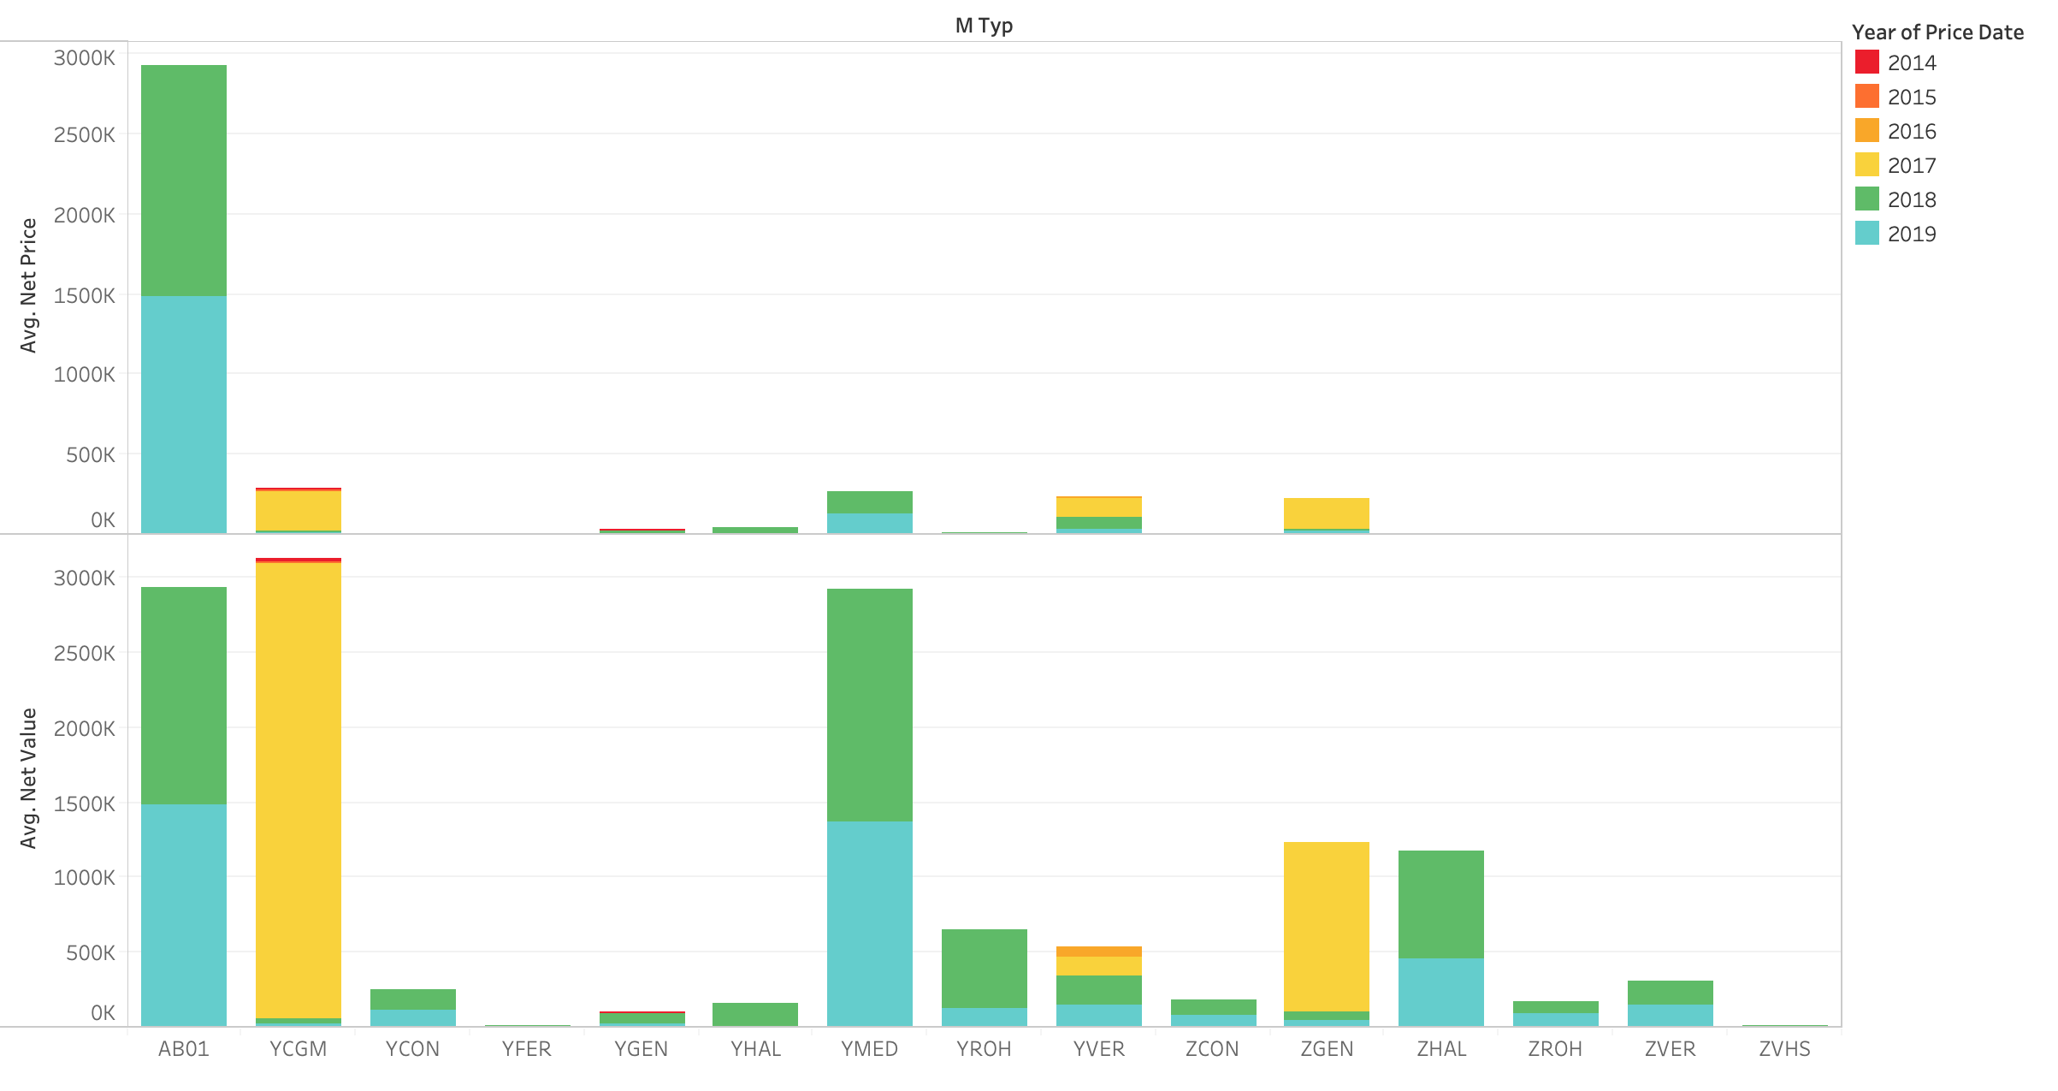

Slide 49
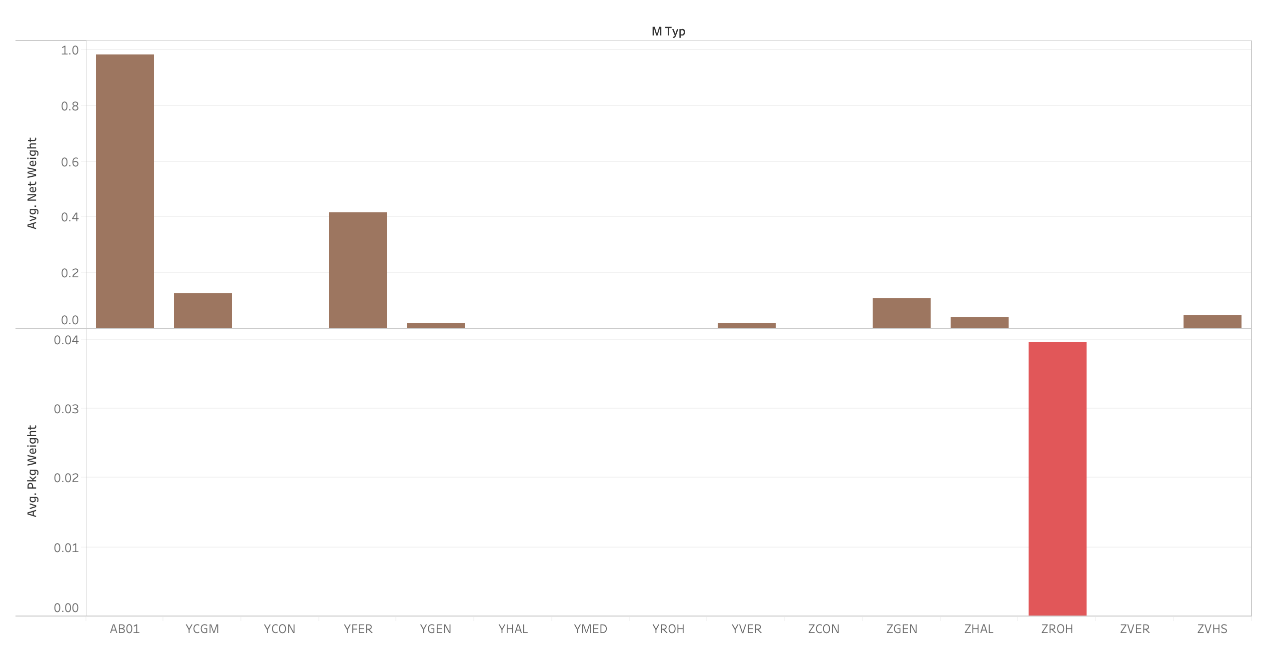

Slide 50
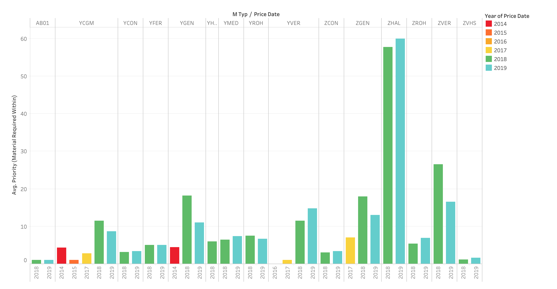

Slide 51
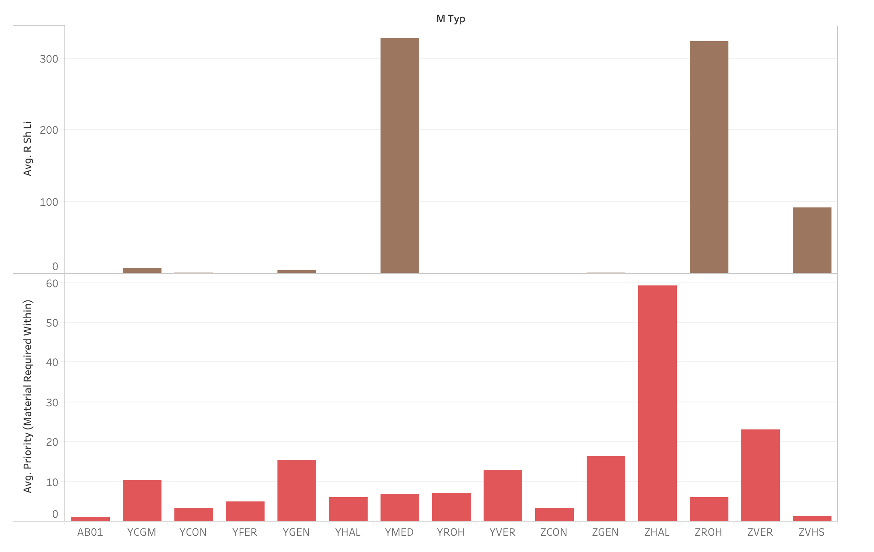

Slide 52
Cluster 2

Slide 53
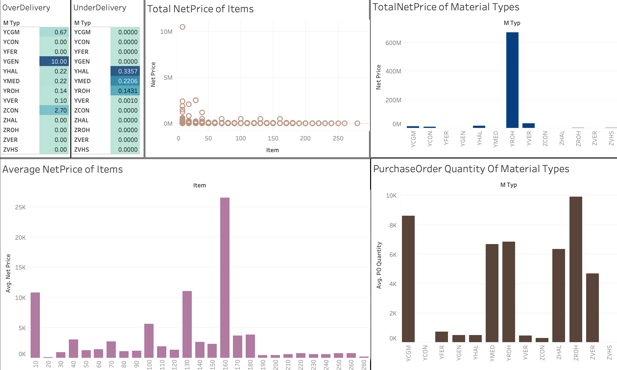

Slide 54
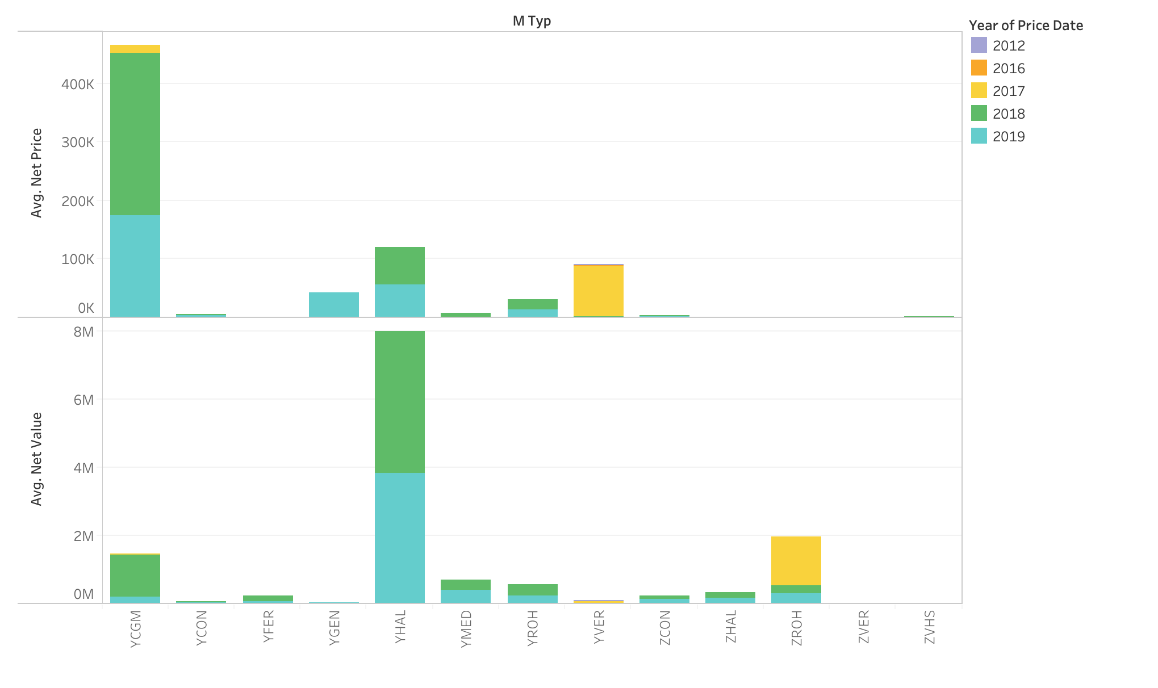

Slide 55
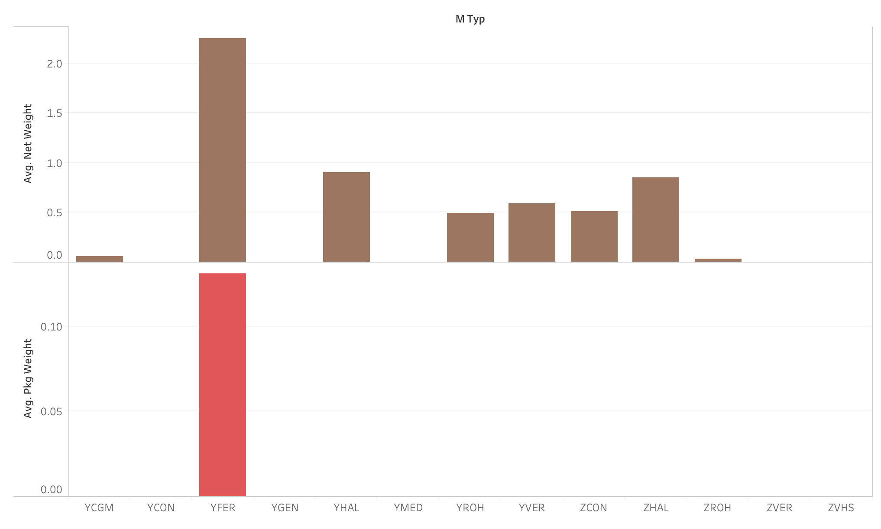

Slide 56
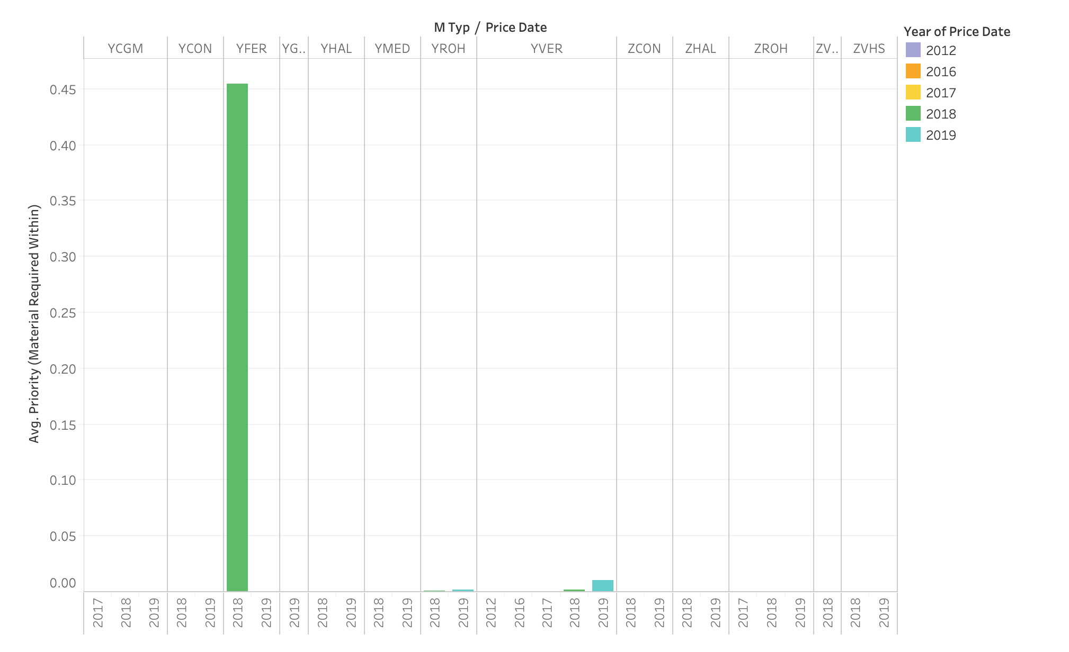

Slide 57
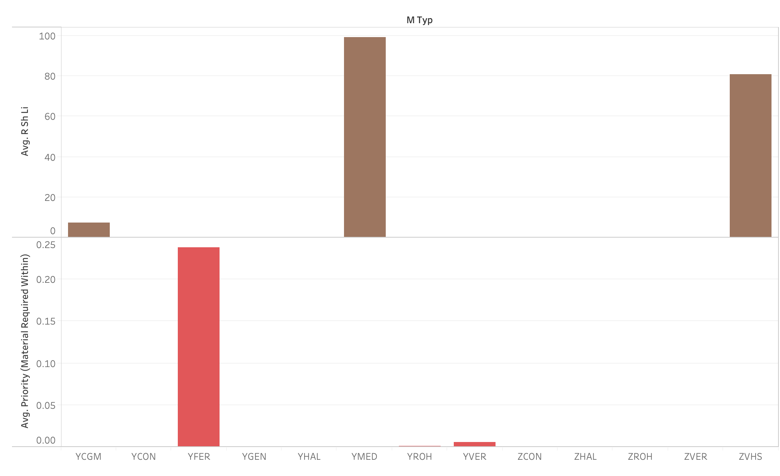

Slide 58
Cluster 3

Slide 59
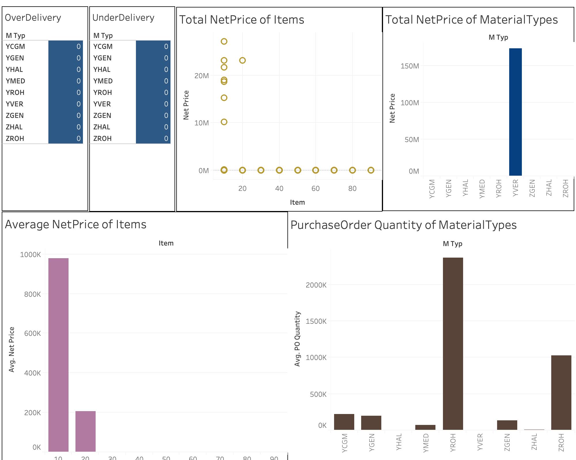

Slide 60
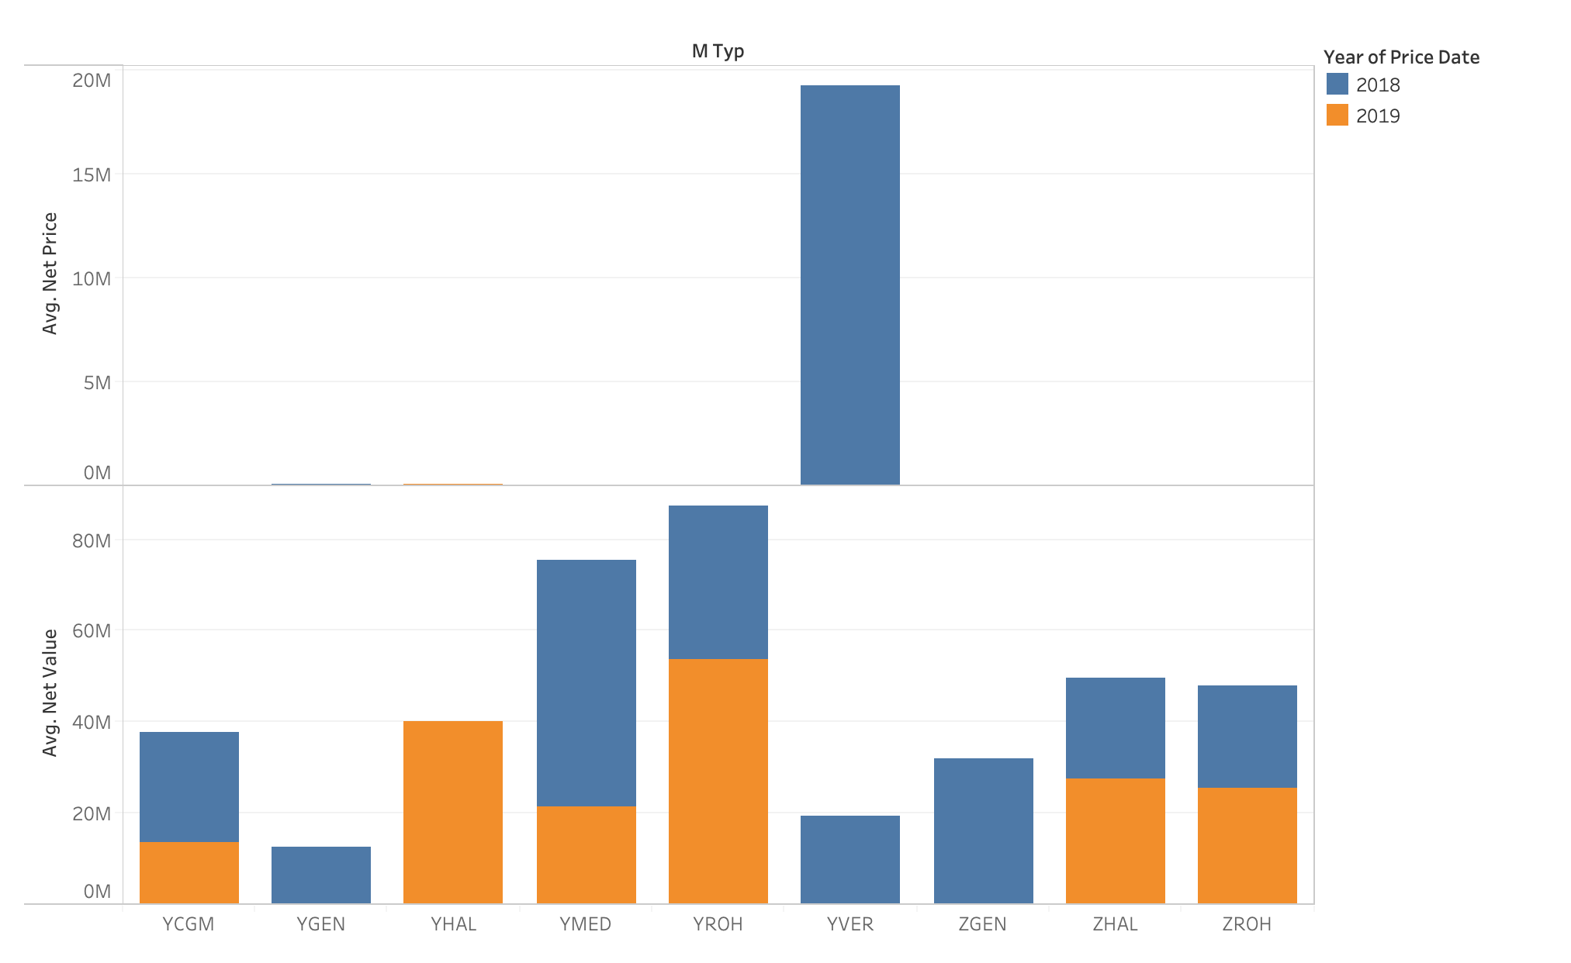

Slide 61
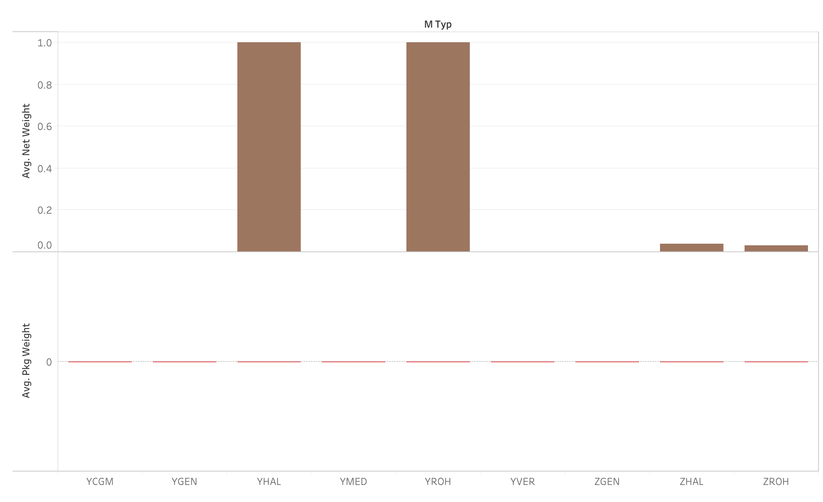

Slide 62
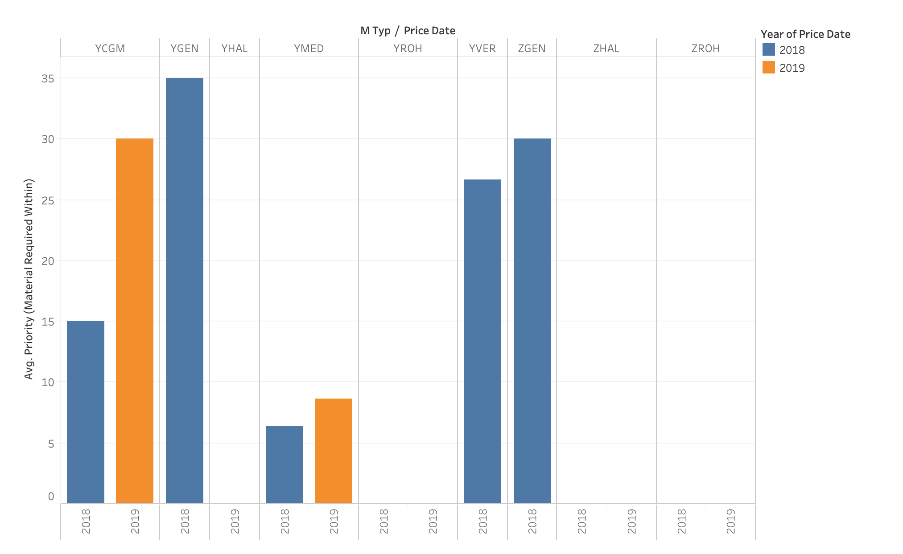

Slide 63
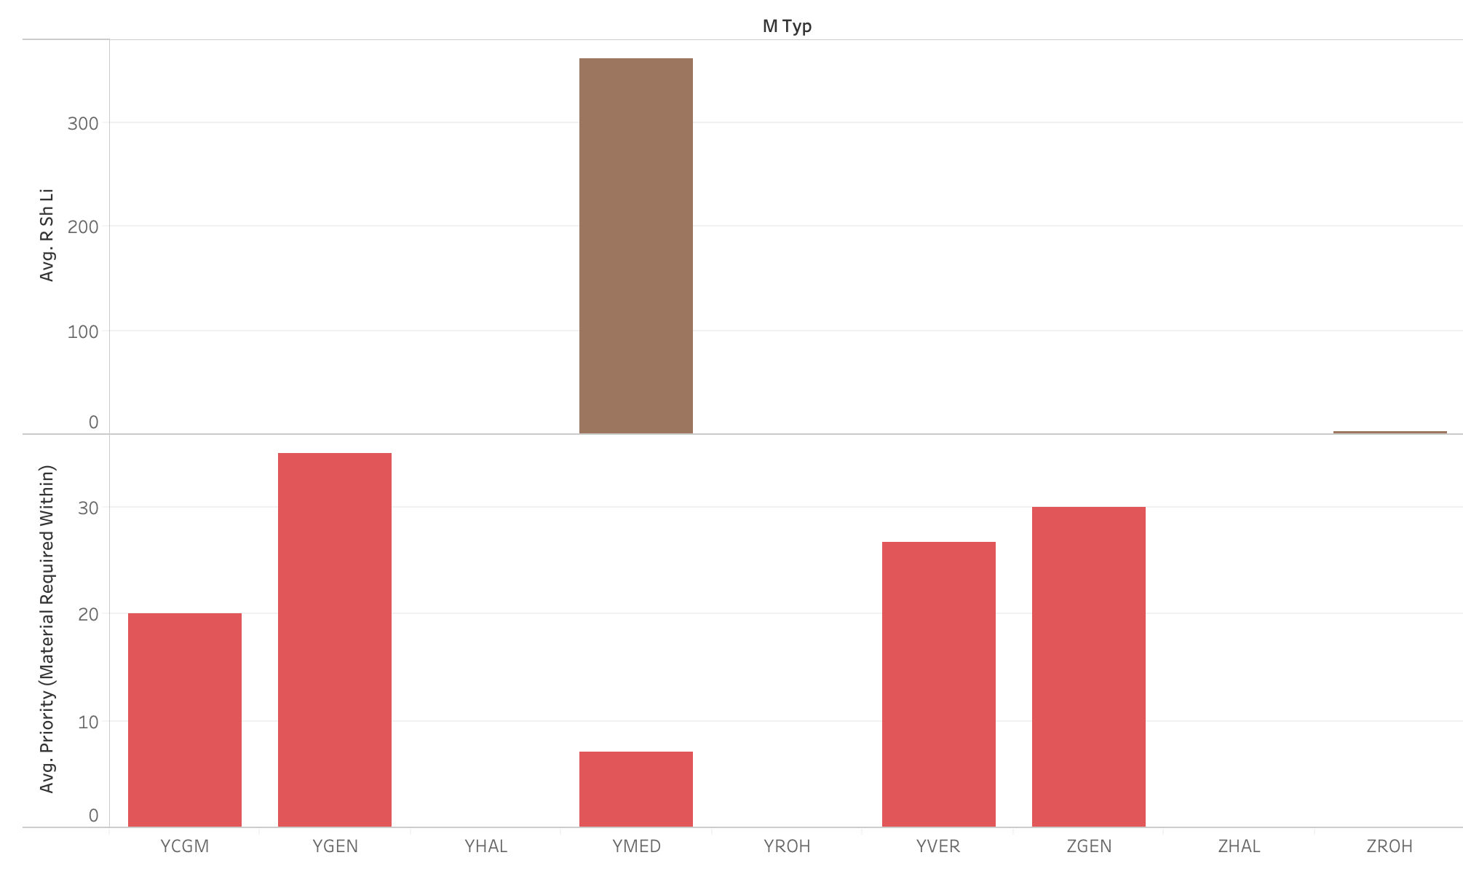

Slide 64
Clusters Evaluation
Evaluation Metrics – Dunn Index
Dunn Index = 1.05

Slide 69
Treating Missing Values

